Slide 1
Automated Relational Meta Learning Accepted in ICLR 2020
Kyeong Ryeol, Go
M.S. Candidate of OSI Lab

Slide 2
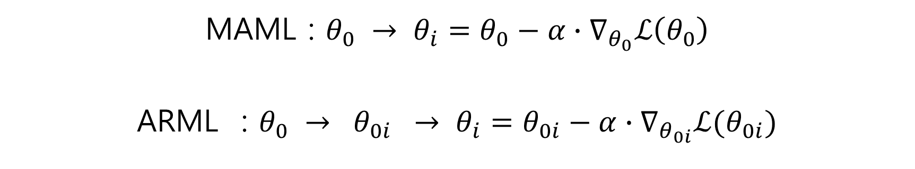
Overview
Motivation
Globally shared meta-learners may not be sufficient to handle diverse tasks
Goal
Customizing the globally shared meta-learners in a task specific manner
MAML : $θ_{0} → θ_{i}=θ_{0}−α∙∇_{θ_{0}}ℒ\left(θ_{0}\right)$
ARML : $θ_{0} → θ_{0i} → θ_{i}=θ_{0i}−α∙∇_{θ_{0i}}ℒ(θ_{0i})$
Graph

Slide 3
Content
Graph structure
Prototype based relational graph
Meta knowledge graph
Super graph
ARML Algorithm
Experiment
Conclusion

Slide 4
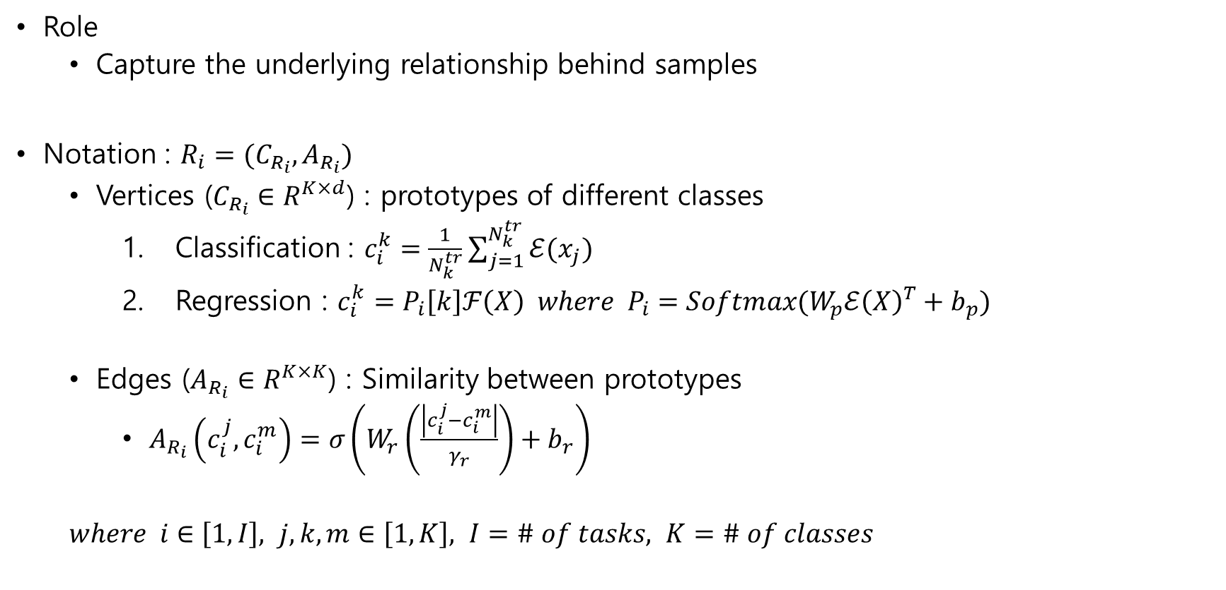
Prototype based relational graph
Role
Capture the underlying relationship behind samples
Notation : $R_{i}=(C_{R_{i}},A_{R_{i}})$
Vertices ($C_{R_{i}}∈R^{K×d}$) : prototypes of different classes
Classification : $c_{i}^{k}=\frac{1}{N_{k}^{tr}}\sum_{j=1}^{N_{k}^{tr}}{ℰ(x_{j})}$
Regression : $c_{i}^{k}=P_{i}\left[k\right]ℱ\left(X\right) where P_{i}=Softmax(W_{p}ℰ{\left(X\right)}^{T}+b_{p})$
Edges ($A_{R_{i}}∈R^{K×K}$) : Similarity between prototypes
$A_{R_{i}}\left(c_{i}^{j},c_{i}^{m}\right)=σ\left(W_{r}\left(\frac{\left|c_{i}^{j}−c_{i}^{m}\right|}{γ_{r}}\right)+b_{r}\right)$
$where i∈\left[1,I\right], j,k,m∈\left[1,K\right], I=\# of tasks, K=\# of classes$

Slide 5
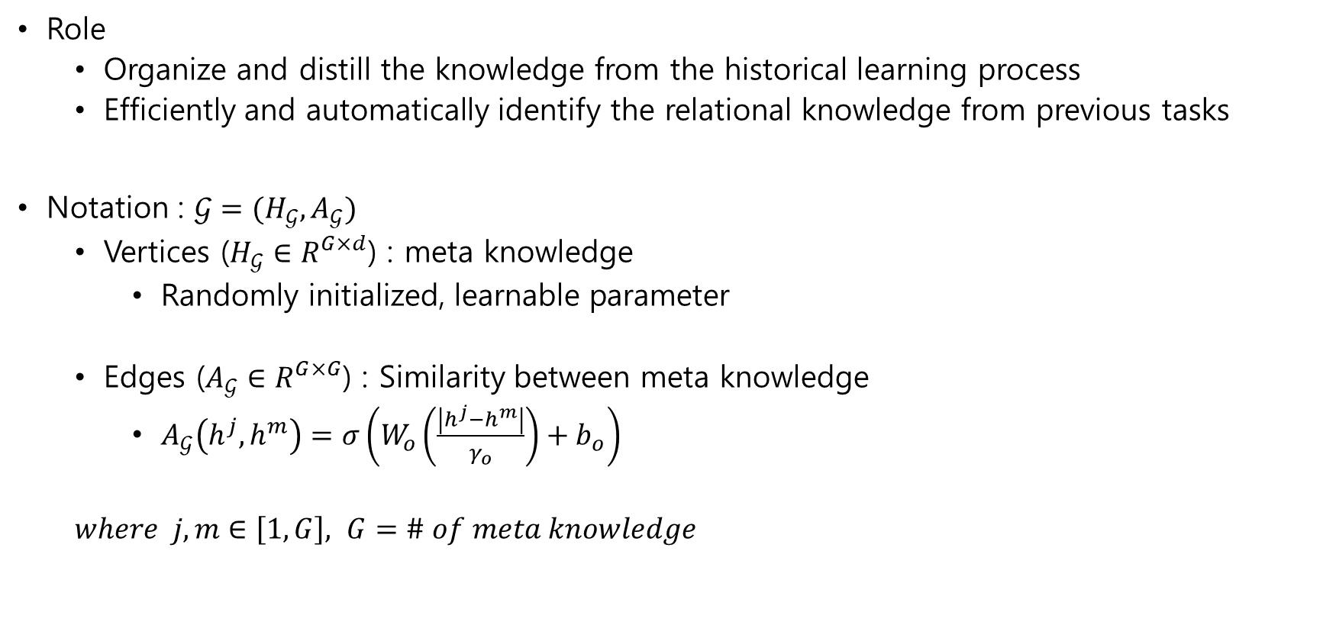
Meta knowledge graph
Role
Organize and distill the knowledge from the historical learning process
Efficiently and automatically identify the relational knowledge from previous tasks
Notation : $𝒢=(H_{𝒢},A_{𝒢})$
Vertices ($H_{𝒢}∈R^{G×d}$) : meta knowledge
Randomly initialized, learnable parameter
Edges ($A_{𝒢}∈R^{G×G}$) : Similarity between meta knowledge
$A_{𝒢}\left(h^{j},h^{m}\right)=σ\left(W_{o}\left(\frac{\left|h^{j}−h^{m}\right|}{γ_{o}}\right)+b_{o}\right)$
$where j,m∈\left[1,G\right], G=\# of meta knowledge$

Slide 6
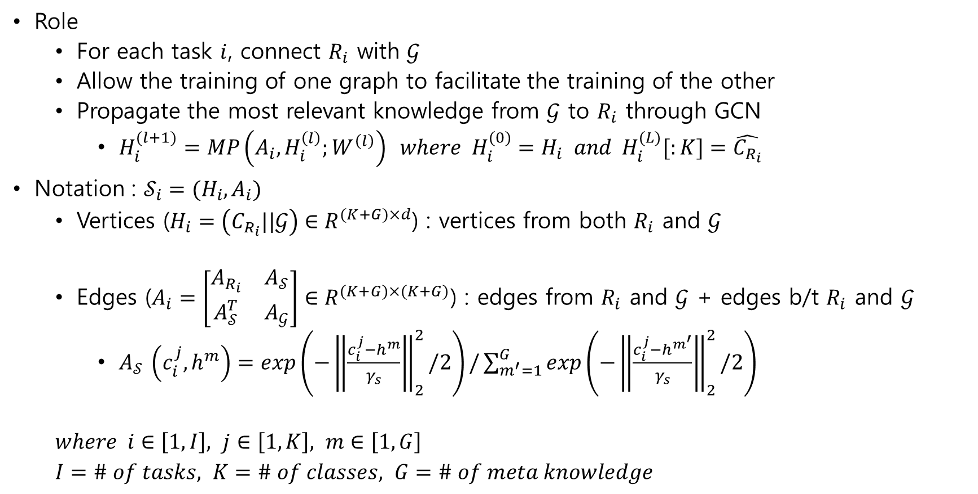
Super graph
Role
For each task $i$, connect $R_{i}$ with $𝒢$
Allow the training of one graph to facilitate the training of the other
Propagate the most relevant knowledge from $𝒢$ to $R_{i}$ through GCN
$H_{i}^{(l+1)}=MP\left(A_{i}, H_{i}^{\left(l\right)};W^{\left(l\right)}\right) where H_{i}^{(0)}=H_{i} and H_{i}^{(L)}[:K]=\hat{C_{R_{i}}}$
Notation : $𝒮_{i}=(H_{i},A_{i})$
Vertices ($H_{i}=\left(C_{R_{i}}||𝒢\right)∈R^{(K+G)×d}$) : vertices from both $R_{i}$ and $𝒢$
Edges ($A_{i}=\left[\begin{matrix}A_{R_{i}} & A_{𝒮} \\ A_{𝒮}^{T} & A_{𝒢}\end{matrix}\right]∈R^{(K+G)×(K+G)}$) : edges from $R_{i}$ and $𝒢$ + edges b/t $R_{i}$ and $𝒢$
$A_{𝒮 }\left(c_{i}^{j},h^{m}\right)=exp\left(−{\left\|\frac{c_{i}^{j}−h^{m}}{γ_{s}}\right\|}_{2}^{2}/2\right)/\sum_{m^{′}=1}^{G}{exp\left(−{\left\|\frac{c_{i}^{j}−h^{m^{′}}}{γ_{s}}\right\|}_{2}^{2}/2\right)}$
$where i∈\left[1,I\right], j∈\left[1,K\right], m∈\left[1,G\right]$
$I=\# of tasks, K=\# of classes, G=\# of meta knowledge$

Slide 7
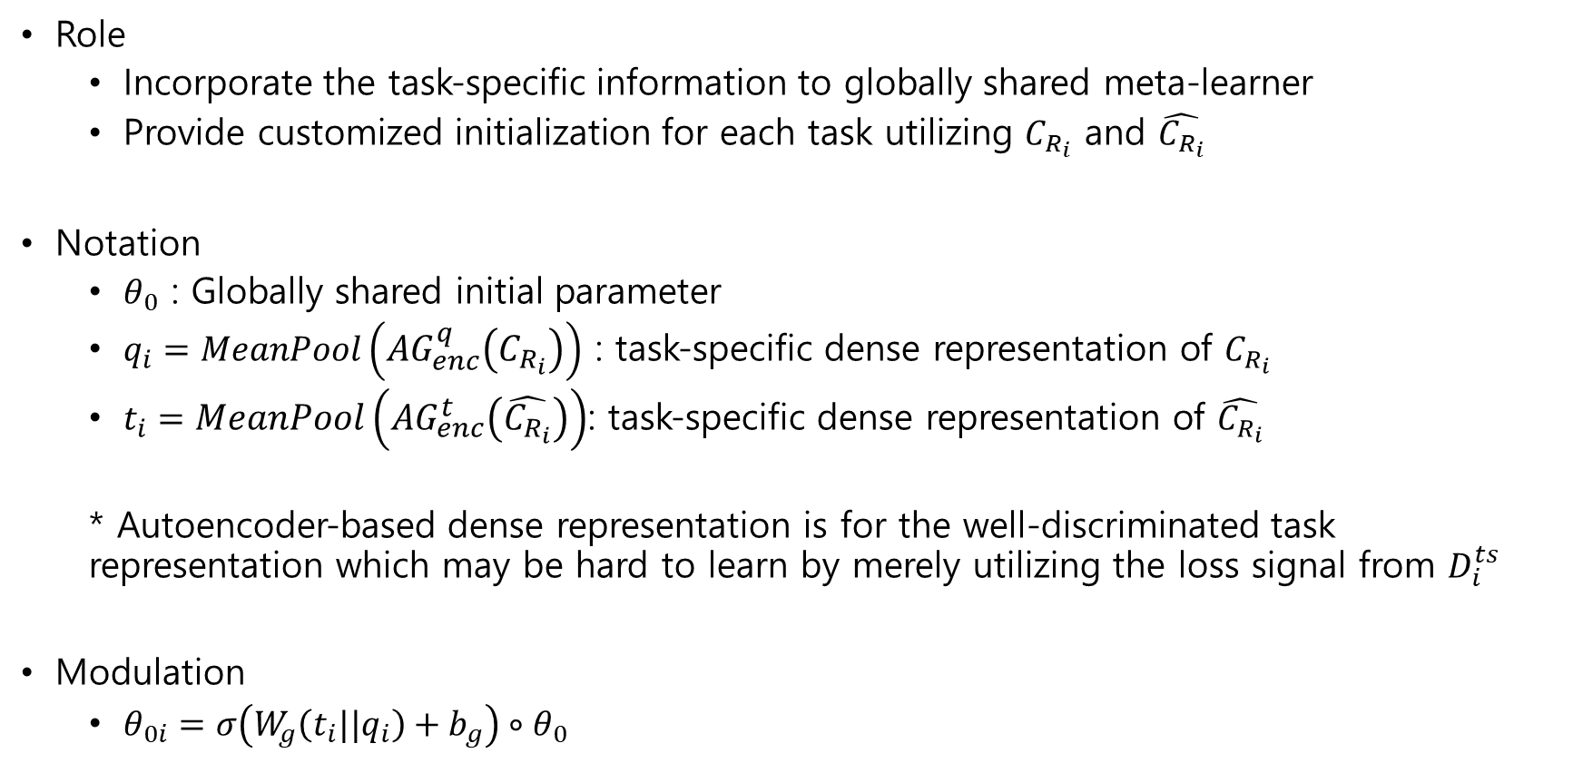
Modulation function ($θ_{0}→θ_{0i}$)
Role
Incorporate the task-specific information to globally shared meta-learner
Provide customized initialization for each task utilizing $C_{R_{i}}$ and $\hat{C_{R_{i}}}$
Notation
$θ_{0}$ : Globally shared initial parameter
$q_{i}=MeanPool\left(AG_{enc}^{q}\left(C_{R_{i}}\right)\right)$ : task-specific dense representation of $C_{R_{i}}$
$t_{i}=MeanPool\left(AG_{enc}^{t}\left(\hat{C_{R_{i}}}\right)\right)$: task-specific dense representation of $\hat{C_{R_{i}}}$
* Autoencoder-based dense representation is for the well-discriminated task representation which may be hard to learn by merely utilizing the loss signal from $D_{i}^{ts}$
Modulation
$θ_{0i}=σ\left(W_{g}\left(t_{i}||q_{i}\right)+b_{g}\right)∘θ_{0}$

Slide 8
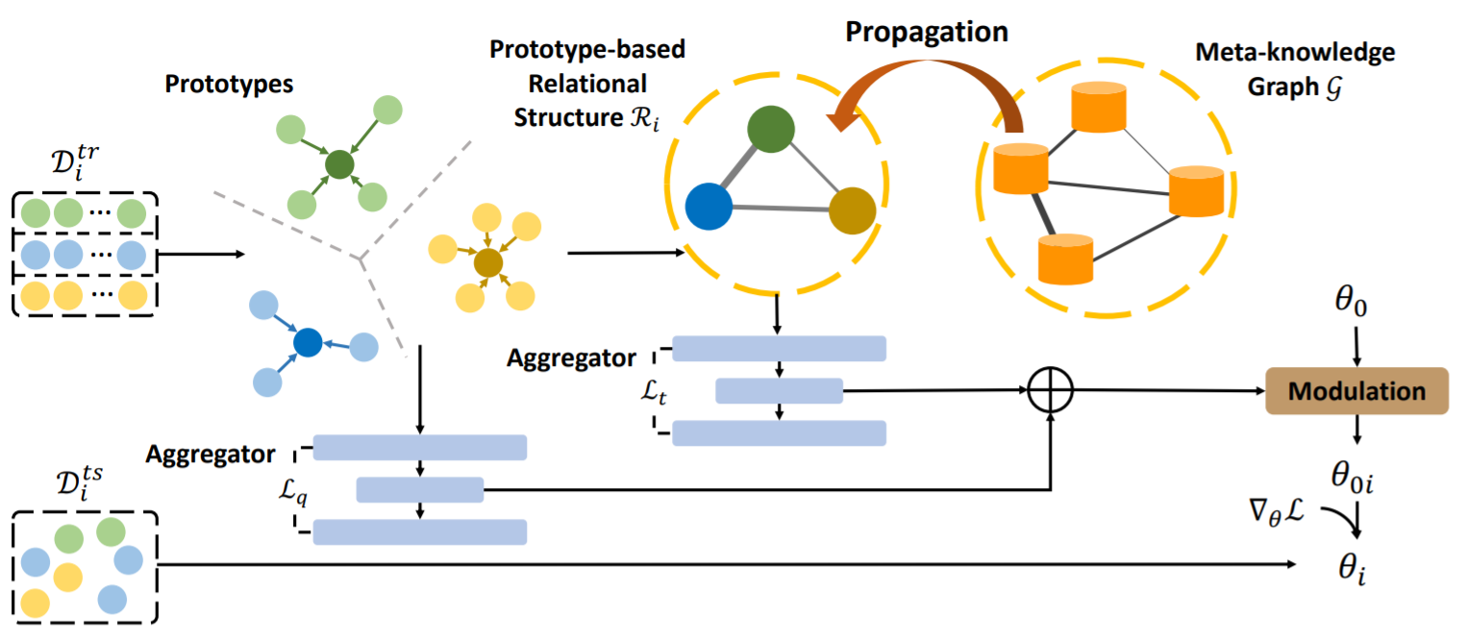
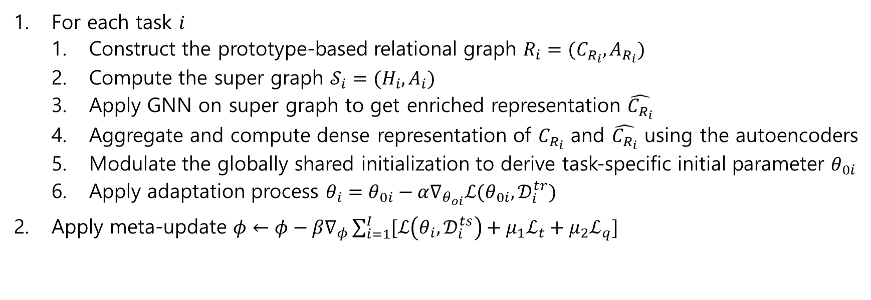
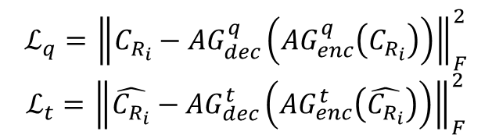
$$ℒ_{q}={\left\|C_{R_{i}}−AG_{dec}^{q}\left(AG_{enc}^{q}\left(C_{R_{i}}\right)\right)\right\|}_{F}^{2}$$
$$ℒ_{t}={\left\|\hat{C_{R_{i}}}−AG_{dec}^{t}\left(AG_{enc}^{t}\left(\hat{C_{R_{i}}}\right)\right)\right\|}_{F}^{2}$$
For each task $i$
Construct the prototype-based relational graph $R_{i}=(C_{R_{i}},A_{R_{i}})$
Compute the super graph $𝒮_{i}=(H_{i},A_{i})$
Apply GNN on super graph to get enriched representation $\hat{C_{R_{i}}}$
Aggregate and compute dense representation of $C_{R_{i}}$ and $\hat{C_{R_{i}}}$ using the autoencoders
Modulate the globally shared initialization to derive task-specific initial parameter $θ_{0i}$
Apply adaptation process $θ_{i}=θ_{0i}−α∇_{θ_{oi}}ℒ(θ_{0i},𝒟_{i}^{tr})$
Apply meta-update $φ←φ−β∇_{φ}\sum_{i=1}^{I}{[ℒ\left(θ_{i},𝒟_{i}^{ts}\right)+μ_{1}ℒ_{t}+μ_{2}ℒ_{q}]}$

Slide 9
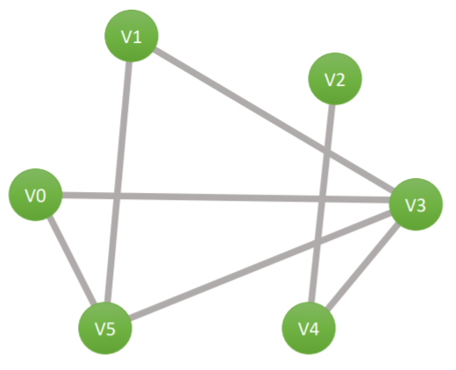
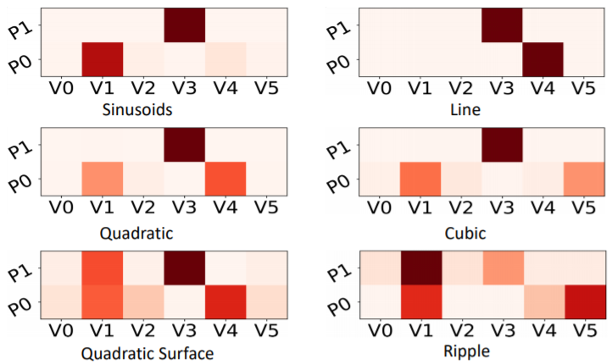

Experiment – 2D regression
3D curve
2 prototypes, 6 meta knowledges
$x\sim U\left[0, 5\right], y\sim U\left[0,5\right]$
Dataset
$z\left(x,y\right)=a_{s}\sin\left(w_{s}x+b_{s}\right)$
$z\left(x,y\right)=a_{l}x+b_{l}$
$z\left(x,y\right)=a_{q}x^{2}+b_{q}x+c_{q}$
$z\left(x,y\right)=a_{c}x^{3}+b_{c}x^{2}+c_{c}x+d_{c}$
$z\left(x,y\right)=a_{qs}x^{2}+b_{qs}y^{2}$
$z\left(x,y\right)=\sin\left(−a_{r}\left(x^{2}+y^{2}\right)\right)+b_{r}$
curve
linear

Slide 10
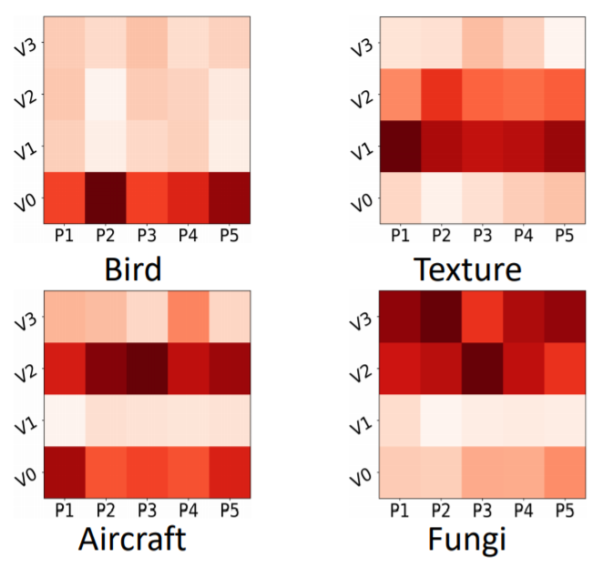
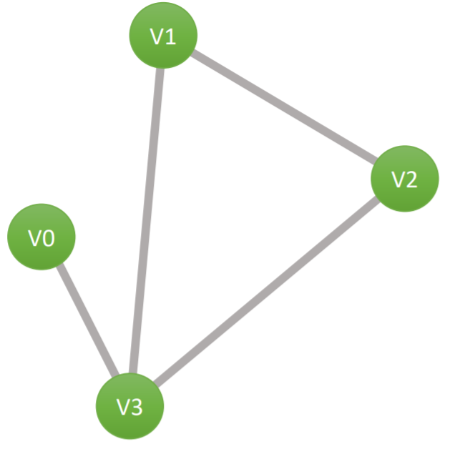
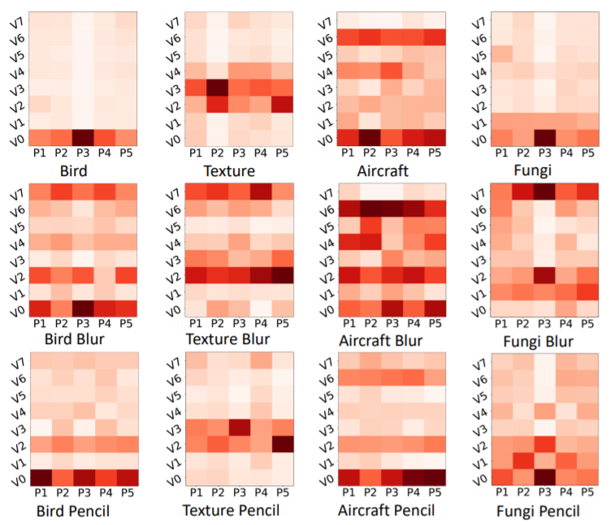
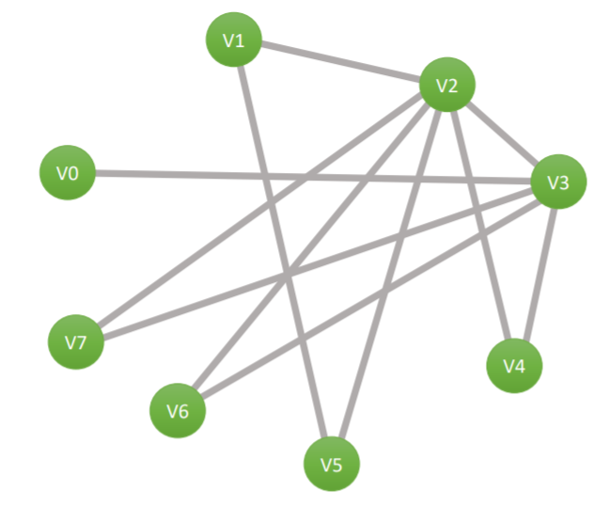
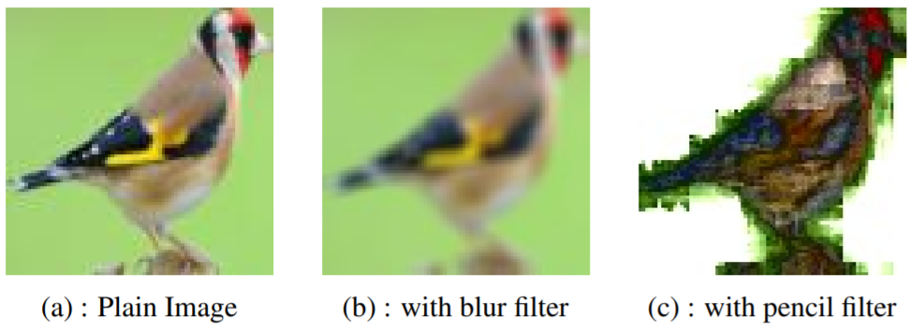
Experiment – classification
texture
5 prototypes, 4 or 8 meta knowledges
Dataset
Plain-Multi
CUB-200-2011
Describable Textures Dataset
FGVC of Aircraft
FGVCx-Fungi
Art-Multi
Plain-Multi
Plain-Multi + Blur filter
Plain-Multi + Pencil filter
bird
aircraft
fungi
pencil
filter
Bird & aircraft
texture
blur
aircraft

Slide 11
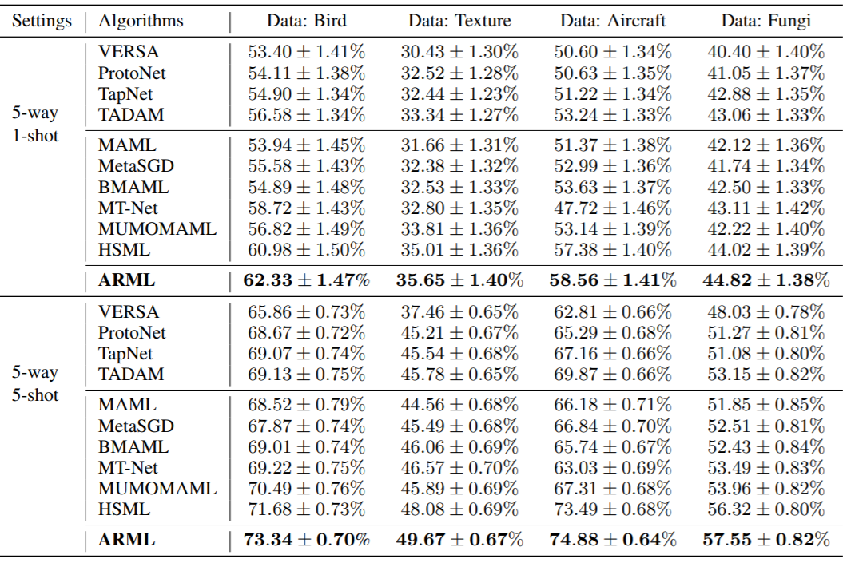
Experiment – quantitative analysis
Plain-Multi

Slide 12
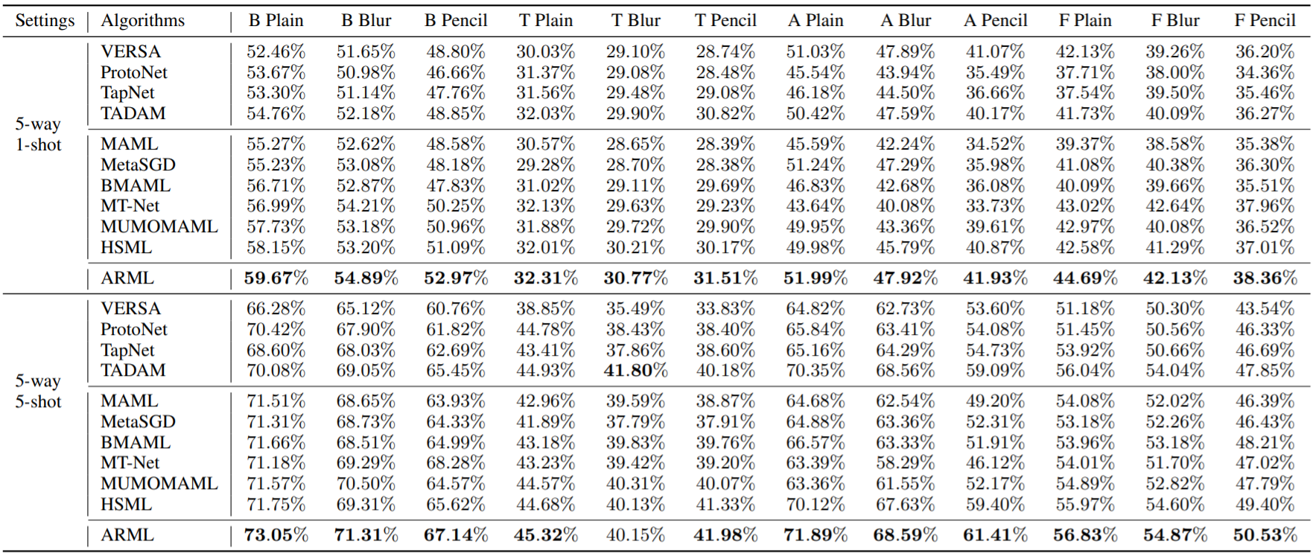
Experiment – quantitative analysis
Art-Multi

Slide 13
Conclusion
Goal
Effective meta-learning for handling heterogeneous task
Contribution
Automatically construct the meta-knowledge graph
Well capture the relationship among tasks and thus improve interpretability
Empirically outperform the state-of-the-art meta-learning algorithms
Proposed future work
Extend ARML to the continual learning scenario
Further investigate the semantical meaning of meta knowledge graph
Further customize the feature space and the label space

Slide 14
Thank you for your attention

